Slide 1
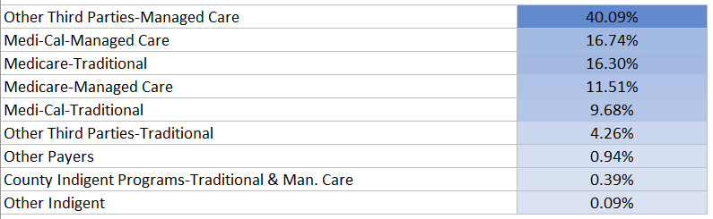
Net Patient Revenue by Payer Category: Pay Type Mix, %
9 Payer Categories
431 Facilities
$16.5B in Combined Net Revenue
Composition Mix Percentage of all Payer Categories

Slide 2
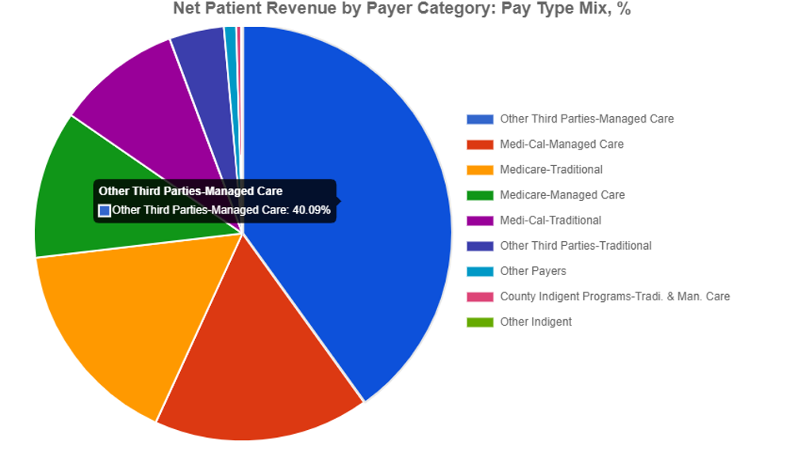

Slide 3
